Slide 1
Parallel Bridge DPT Results

Slide 2
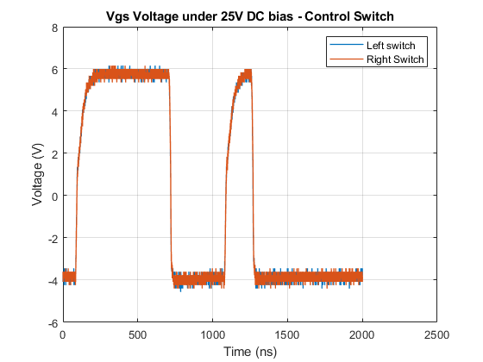
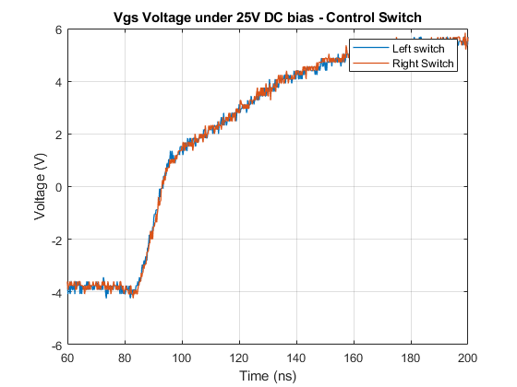
Parallel Bridge DPT Results
Control switch waveforms
Parallel switches act together

Slide 3
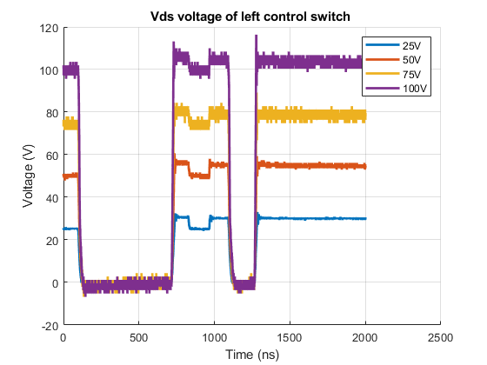
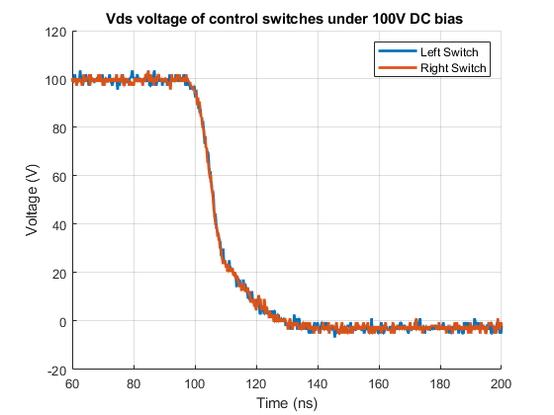

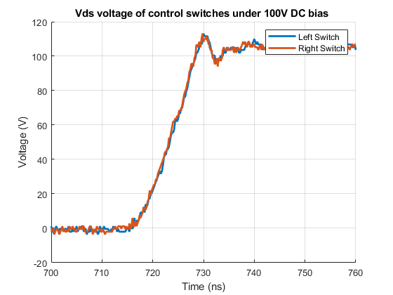
Single Bridge DPT Results
Control switch waveforms
Parallel switches act together

Slide 4
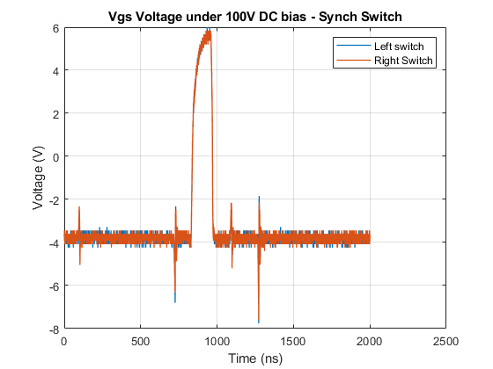
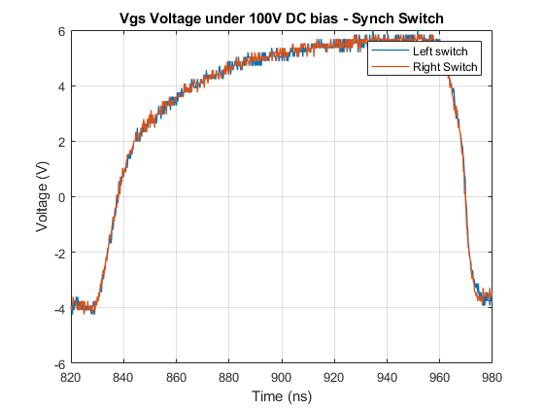
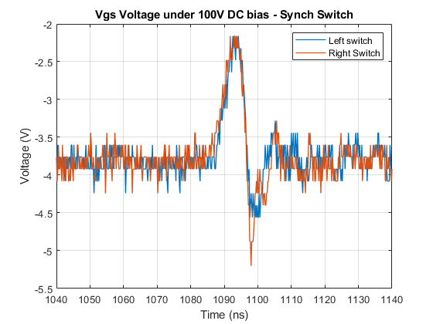
Parallel Bridge DPT Results
Synch switch waveforms

Slide 5
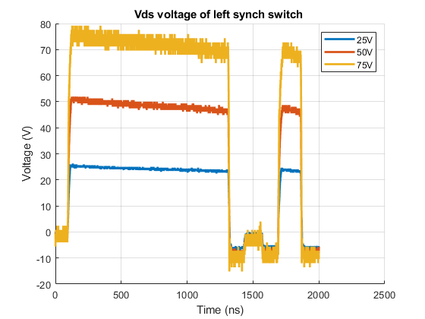
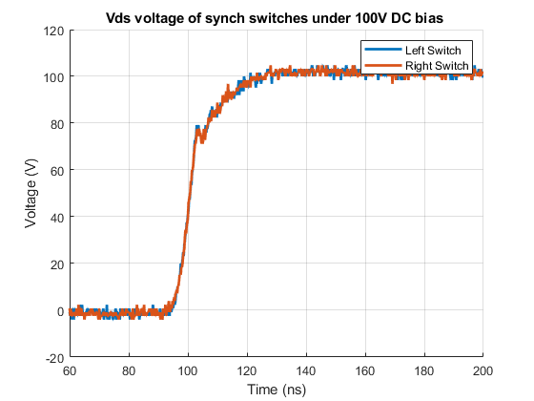
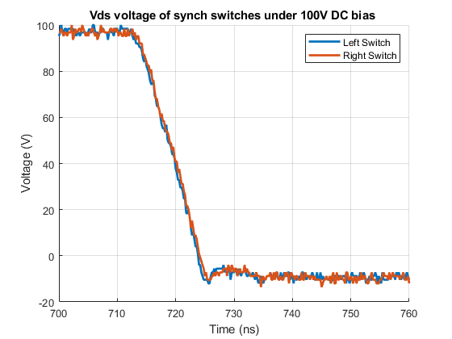

Single Bridge DPT Results
Synch switch waveforms
Parallel switches act together

Slide 6
Thermal Tests

Slide 7
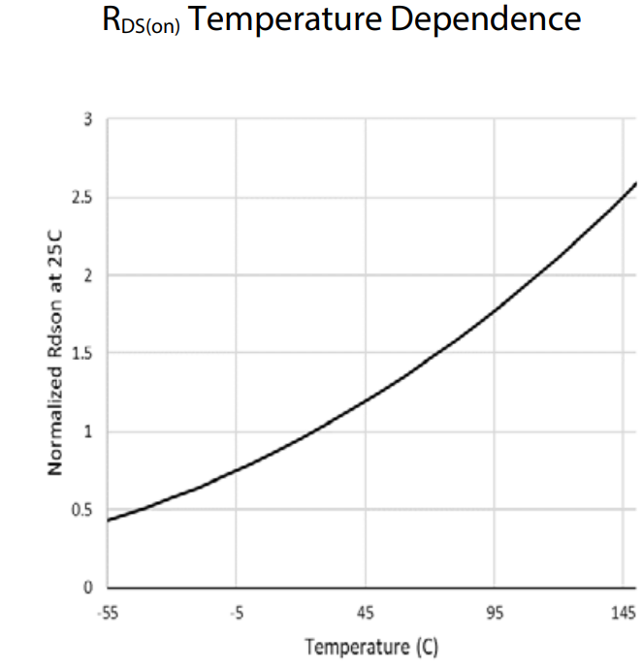
Thermal Tests
Controlled loss is applied to transistors
Applied loss is significantly dependent on the junction temperature

Slide 8
Thermal Tests
Controlled loss is applied to transistors
Applied loss is significantly dependent on the junction temperature

Slide 9
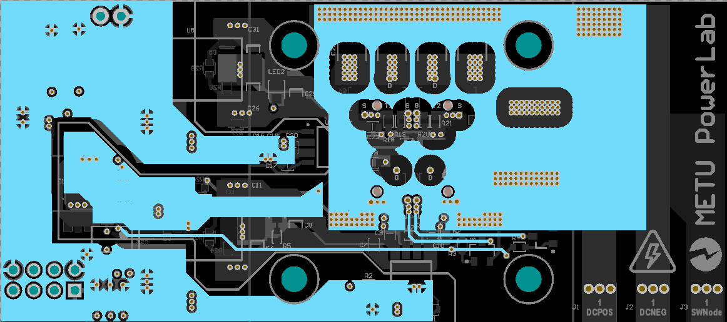
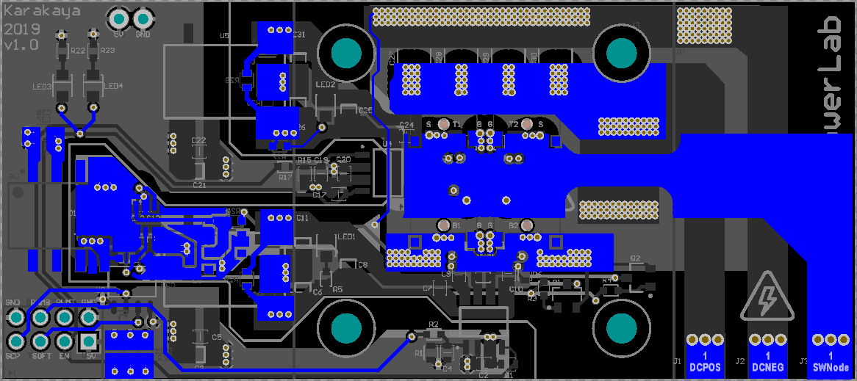
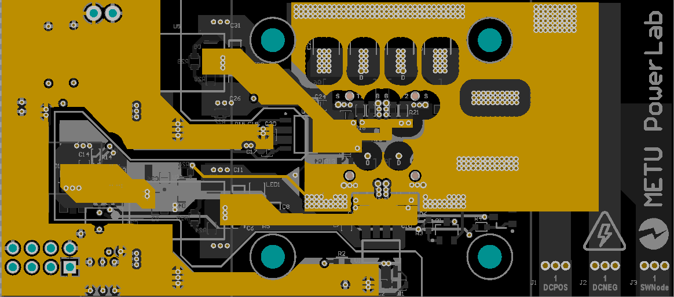
Thermal Tests
0.5 C/W
Measured
T_{case-top} -> 100 ˚C
T_{case-bot} -> 90 ˚C
Power Loss -> 7.09A²*0.05Ω = 2.5 W (Wrong)
Here having different temperatures between top and bottom temperatures is quite intersting.
18 C
Wider copper area for source pin of bottom transistor
Smaller copper area for source pin of top transistor

Slide 10
Thermal Tests
Measured
Theatsink -> 69.8 C
Vgan = 435 mV
Igan = 7.5 A
Ploss = 3.26 W
Thermal resistance of HS 15.87 C/W heatsink resist.
Estimated J. Temp = 83 C
0.5 C/W
3.5 C/W
15.87 C/W
18 C
7.5 A source current

Slide 11
Thermal Tests
Measured
Theatsink -> 64.5 C
Vgan = 389 mV
Igan = 7 A
Ploss = 2.723 W
0.5 C/W
3.5 C/W
15.87 C/W
18 C
Analytical
Theatsink(calculated) = 61.2 C
The environment was hotter it might be 1 or 2 celcius higher
7 A source current

Slide 12
Thermal Tests
Measured
Theatsink -> 53.7 C
Vgan = 305 mV
Igan = 6 A
Ploss = 1.83 W
0.5 C/W
3.5 C/W
15.87 C/W
18 C
Analytical
Theatsink(calculated) = 47 C
6 A source current

Slide 13
Thermal Tests
Better TIM
is a must!
Fan is a must!
What is estimated?
If we use the better TIM pad, Rtim will be 2.5 K/W
For 6 mm HS with Fan
Rhs = 4.6 K/W
Maximum loss is 12.8 W for 130C of junction
For 10 mm HS with Fan
Rhs = 3.6 K/W
Maximum loss is 16.7 W for 130C of junction
For 13 mm HS with Fan
Rhs = 2.9 K/W
Maximum loss is 18.6 W for 130C of junction
0.5 C/W
3.5 C/W
15.87 C/W
18 C
16.7 W loss is estimated per half-bridge board under full load

